Slide 1
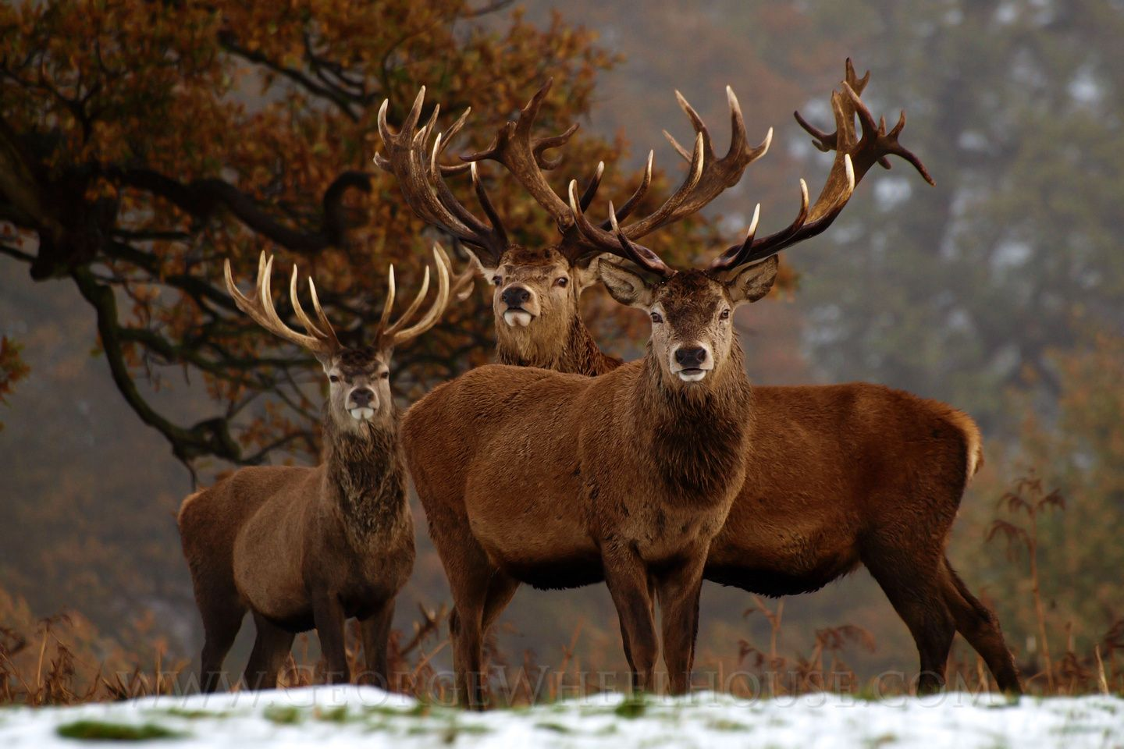
niyanan apisimôsosak
We are Deer…

Slide 2
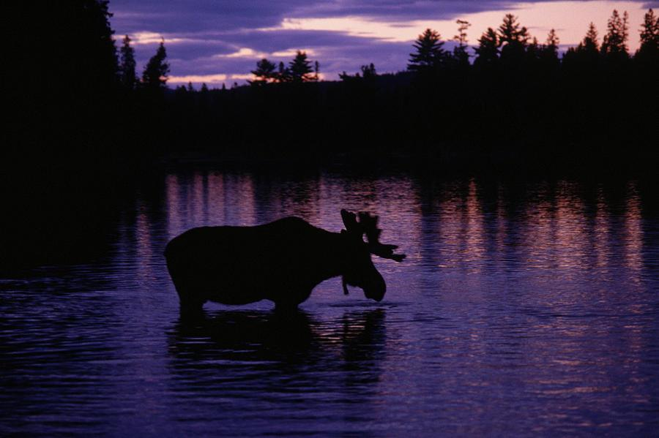
peyakwaw esa… (This one time…)
awa môswa ê-kî-minihkwêyit nipîy sâkahikanihk (this moose was drinking water at the lake)
kêtahtawê awa môswa kî-pêhtawêw nâway (suddenly this moose heard something behind)

Slide 3
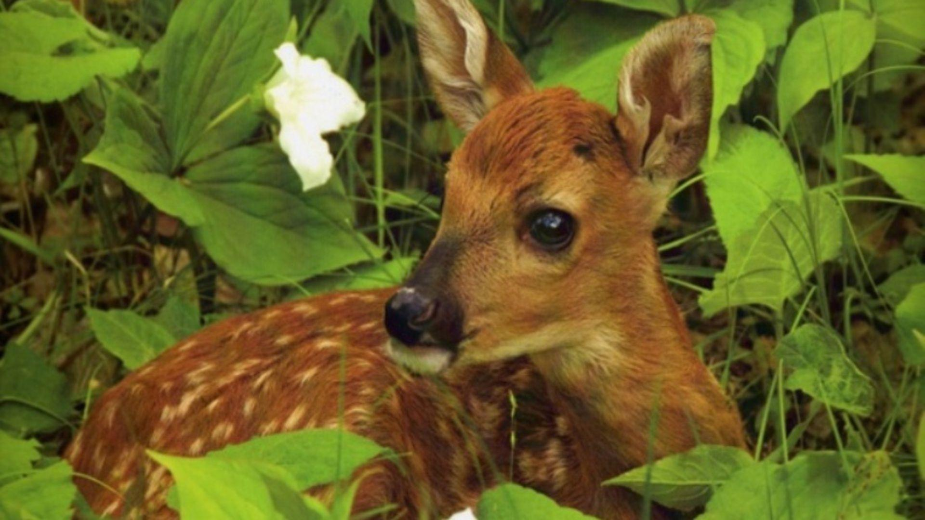
awa môswa kî-pêhtawêw “wicihin! wicihin!” ekwa kî-kanawâpahtam sakâhk
ayâw apisimôsos ê-kî-nitawâpit môswa (This moose heard “help me! Help me! And looked in the bush and there was a deer looking at the moose)
apisimôsos kî-wâpamêw môswa ekwa kî-itwêw “nikâwiy!” (The deer saw the moose and said “mama!”

Slide 4
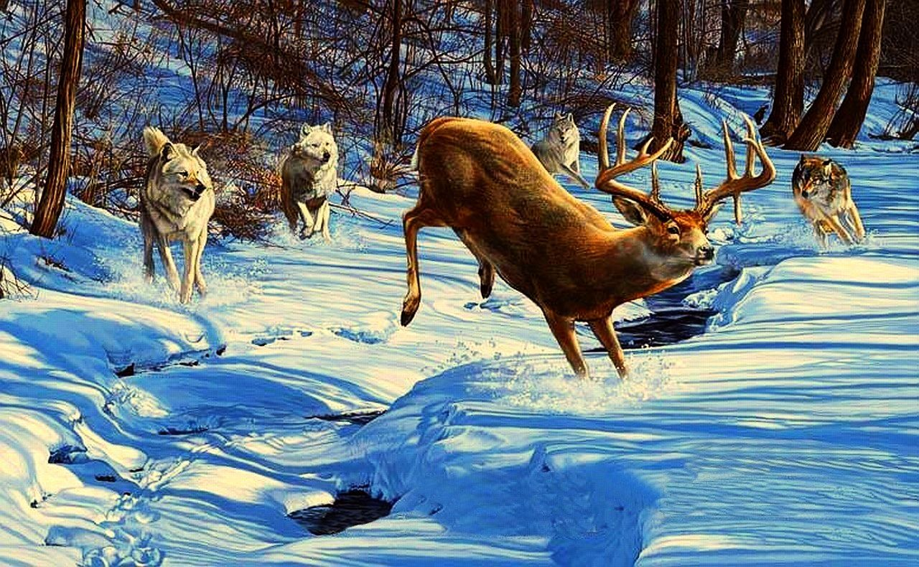
awa môswa kî-itwêw “wahwâ! namoya nikâwiy môswa niya tâniwâ kikâwiy”
This moose said “oh jeez! I am not your mother I am a Moose, where is your mother?”
awa apisimôsos ê-kî-sôhki-mâtot “awa mahihkan kî-pê-otinamâsow nikâwiy”
The deer started crying “this wolf came and took my mother”

Slide 5
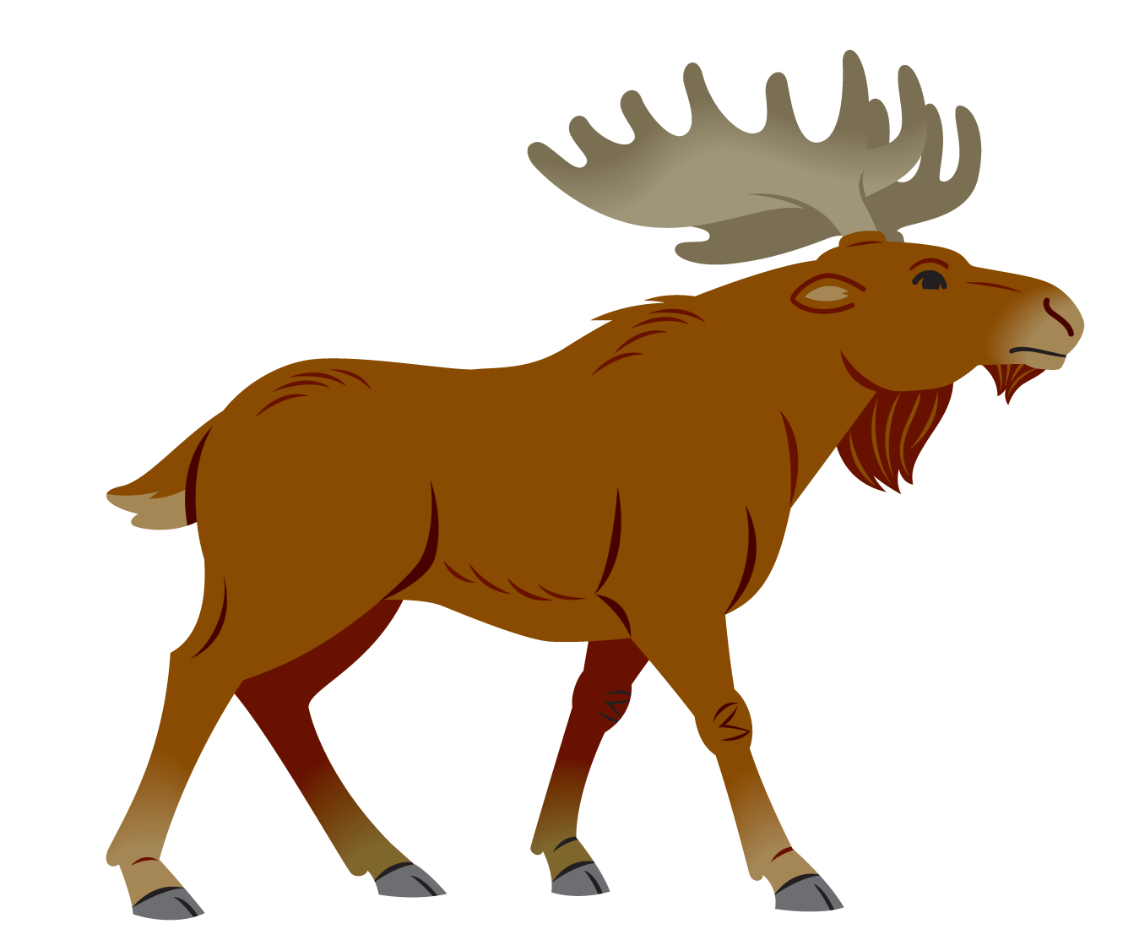
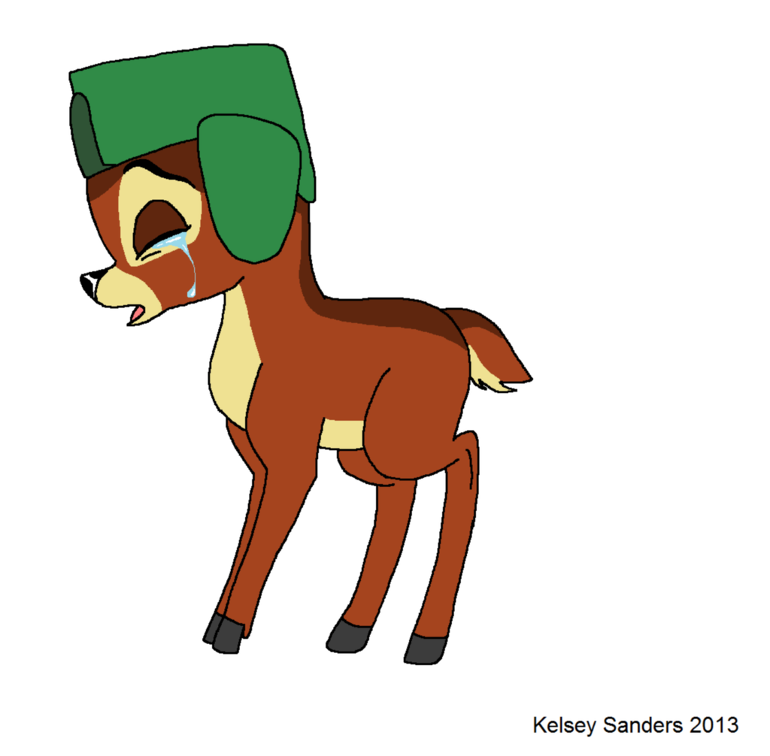
“ah awâsis kihci-manitow kî-otinamâsow kîkawiy namoya mahihkan” kî-itwêw môswa (“ah child, the Great Spirit took your mother not the wolf” said the moose)
apisimôsos ekwa môswa ê-kî-mâci-âkwaskitinitocik (the deer and moose began hugging eachother)

Slide 6
êwako môswa kî-itwêw “ah kiyâm awâsis ê-mâci-nâkatawêyimitân kiya êkwa” That moose said “don’t worry about it child, I will begin taking care of you now”
“pê-nikâkîsimonân awâsis kâmwâtan anohc mâka nimaskawisînân
“Come pray child, today was sad but we are strong””
“Pimâtisiwin ana niyanan apisimosôsak mâka manito ê-sâkihisk êkwa asamâwasoyiwa ”
“ This is life for us deer but the Creator is loving and provides for his children”
êkosi
That is all

