Slide 1
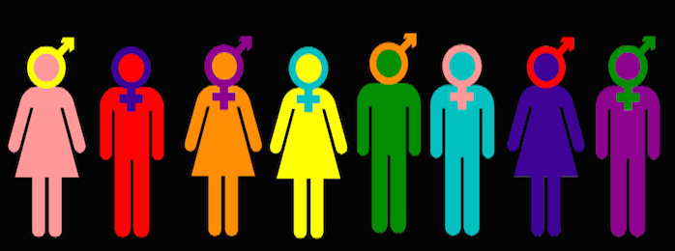
GENDER & SEXUALITIES
INTERDISCIPLINARY PLANNING

Slide 2
Introduction
Gender and Sexualities
Gender is all about how people feel on the inside and express themselves on the outside. It's not just about being a boy or a girl. Someone may feel like a boy, a girl or both, neither, or something else entirely. It’s important to understand that gender is not the same as biological sex, which is determined by physical and genetic characteristics. It can be seen from different angles like Identity, Spectrum, and expressions.
Sexualities include a wide range of sexual alignments and attractions that persons may experience. Sexual orientation/alignment refers to a person’s emotional, romantic, and sexual attraction to others. In simple words, It's like having a crush, but it can be on boys, girls, or anyone else, depending on who you are.

Slide 3
Importance of topic
Learning about gender and sexuality is like discovering that people can be different in many ways, and that's totally fine. It helps us be nice and not tease others because of who they are or who they like, just like not making fun of someone for liking a different color. Understanding our own feelings and what makes us happy makes us feel good, like finishing a puzzle and being proud of it. Sometimes, our friends might have questions, and when we know about these things, we can be good friends and help them feel better. It also helps us be really good friends to everyone, no matter who they are or who they like, which is like having a special superpower of kindness and acceptance. So, it's important to learn about these things because it keeps us safe, helps us be great friends, and makes the world a kind place for everyone.

Slide 4
Video
Let's Talk about Bodies, Gender and Sexual identity through a video

Slide 5
How might you enact gender equity during your pre-internship field experience? Sketch out some practical ways that you could practice gender equity and gender-friendly pedagogies as a teacher.
During my internship, I can promote gender equity by actively supporting and encouraging equal opportunities for all individuals, regardless of their gender. This can include advocating for inclusive policies, fostering a respectful and inclusive work environment, and actively participating in initiatives or discussions that promote gender equality. It's important to create a supportive and empowering atmosphere where everyone's contributions are valued and respected.
I think below are the practical ways to practice gender equity and promote gender-friendly pedagogies as a teacher:
I will use language that includes everyone, avoiding gender stereotypes. Instead of saying "boys and girls," use phrases like "everyone/students" or address students by their names.
I will encourage all students, regardless of their gender, to actively participate in class discussions and activities. I will also make sure that everyone has an opportunity to share their thoughts and ideas.
I will incorporate diverse perspectives and voices in my teaching materials and lessons. Will carefully choose books and examples that reflect the experiences of all genders and cultures.

Slide 6
4. I’ll try to treate a safe and respectful space for open discussions about gender-related topics. Will boost up students to ask questions and share their thoughts, fostering understanding and empathy among peers.
5. To provide equal opportunities for all students to take on leadership roles in the classroom and check that leadership positions are not gender-biased.
6. I’ll Promptly address teasing, bullying, or exclusion based on gender.
7. Will advocate about gender-neutral bathrooms and facilities to accommodate all students comfortably in my school.
8. will create a classroom atmosphere where everyone's contributions are valued and respected.
9. I will continuously educate myself on gender equity and gender-friendly teaching practices through workshops, training, and resources.
10. Will work on highlighting teamwork, collaboration, and cooperation over competition based on gender amongst my students.
11. Will do storytelling and will share stories and examples of individuals who have defied gender stereotypes and achieved success in various fields to inspire all students.

Slide 7
How does the information about creating gender-friendly classrooms affect what you believe about teaching and learning (i.e. the purposes of education)?
Creating classrooms where everyone should feel safe and respected, no matter if they are a boy, girl, or something else. It teaches us to be kind to others who might be different from us, like understanding that some kids might like different things or dress differently, and that's totally okay. It helps us learn better because we're not worried about being treated unfairly. When we learn about these things in school, it helps us to be better friends, learn more, and grow up to be good, respectful people / person in the world. So, making classrooms that are friendly to all genders is a great way to make education better for everyone. Welcoming every student should be the approach keeping an inclusive classroom.

Slide 8
Q’s by Guests
Aziza – What are the challenges faced by transgender and gender-nonconforming individuals in society? How can educators and institutions promote inclusivity and support for LGBTQ2?
Khushbu - What kind of gender based barriers exist in the school premises which could impact student learning and what can be the ways to eliminate these barriers?
Blue - What is your opinion as a future educator in Saskatchewan on policy requiring students under 16 years old to seek parental consent before changing their pronouns or preferred first names in a school setting? Furthermore, could this be hindering gender and sexuality in Saskatchewan schools?

