Slide 1
Is Climate Change Real?
Essential Questions:
1. What will happen if we lose the planet earth which sustains us, feeds us and connects us?
2. Who is to blame climate change?
3. Whose responsibility is to do something on climate change?

Slide 2
Curriculum Outcomes:
Outcome: DR5.2
Assess the impact of the environment on the lives of people living in Canada.
Outcome: DR7.2
Appraise the impact of human habitation on the natural environment in Canada, and in a selection of Pacific Rim and northern circumpolar countries.

Slide 3
World population
Human population growth has been on the increase for the last two decades, and it is estimated 7.5 billion in the year 2017 according to United Nations estimate data.

Slide 4
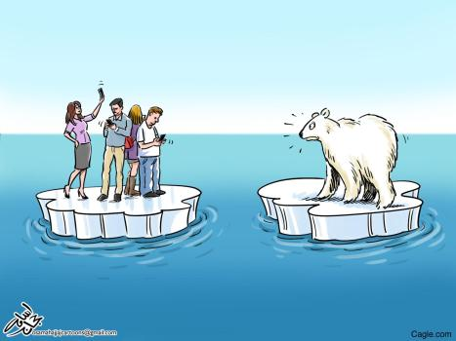
The melting of glacier

Slide 5
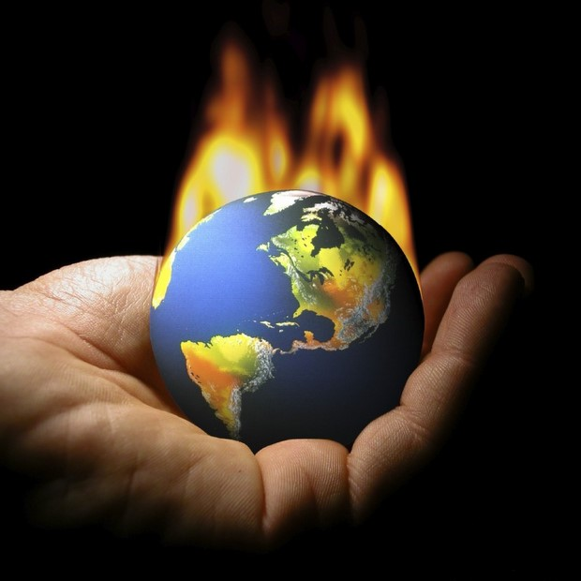
Global Warming

Slide 6
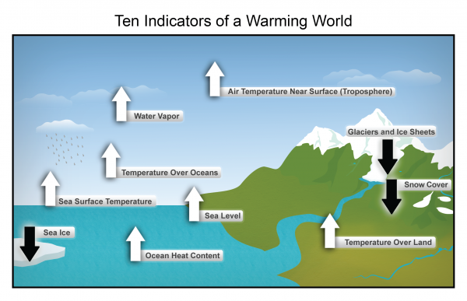
Ten indicator of global warming

Slide 7
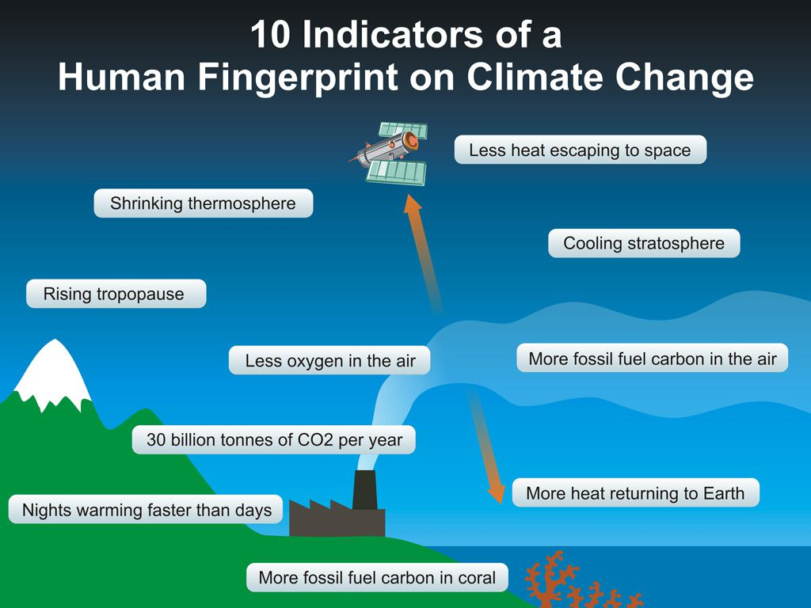
How do we know global warming is real?

Slide 8
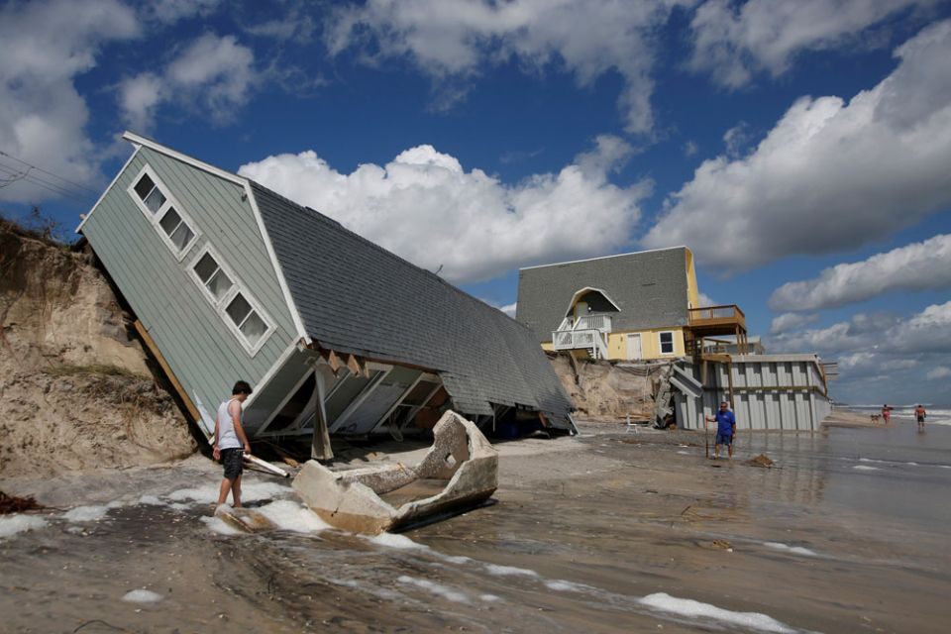
Floods washing away villages

Slide 9
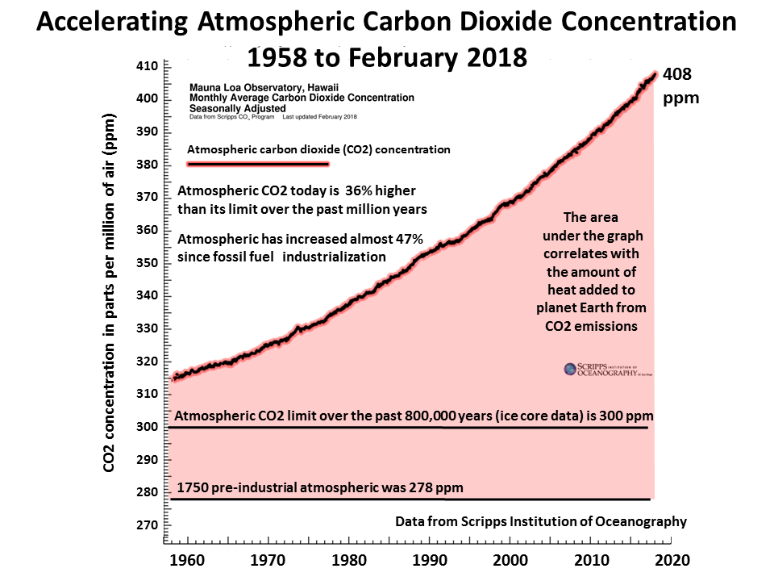
Atmospheric Carbon dioxide

Slide 10
Scientific evidence/facts of climate change
https://climate.nasa.gov/evidence/
Global temperature rise
Warming Oceans
Shrinking ice Sheets
Glacial retreat
Decrease snow cover
Sea level rise
Declining arctic sea ice
Ocean acidification/ extreme events(weather calamities)

Slide 11
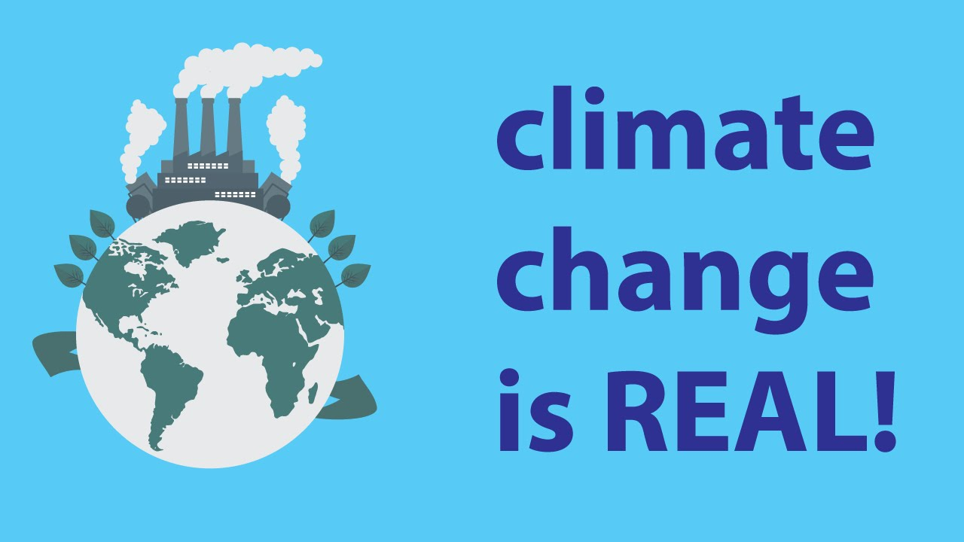
Believe me, Climate Change is Real!!

Slide 12
Resources/References
https://climate.nasa.gov/resources/education/
https://climatekids.nasa.gov/
Canada's climate has been warming at roughly twice the rate of the rest of the world. In Northern Canada, it's even higher.
https://www.cbc.ca/news/opinion/climate-change-report-1.5079886
Climate change rooted in indigenous teaching.
https://www.cbc.ca/news/canada/saskatchewan/michelle-brass-climate-change-future-40-1.4954839?fbclid=IwAR12aqB--qT06L4gplmH8Sd0vr5yCxsJuhrwbR0yLcYAfFq6RtazeAoGqA0

Slide 13
Continued.. Resources
Activity sheets
Handouts
Lesson plans
Learning guides
Community connections
Videos
http://climatechangeconnection.org/resources/climate-friendly-schools/resources-for-schools/

Slide 14
Nine Questions About Climate change and their answers
https://www.vox.com/science-and-health/2017/6/1/15724164/9-questions-climate-change-too-embarrassed-to-ask

